Slide 1
Introducing AeroBi
GKN Filton | Productivity Tracker

Slide 2


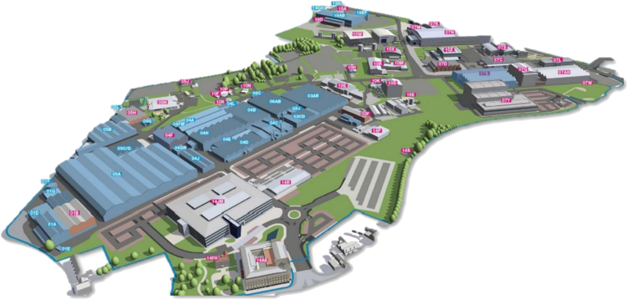



An all-in-one Business Area - Value Stream –
Work Center Productivity Tracker
Based on Microsoft Fabric the tracker can be viewed on a web browser or Microsoft PowerBi mobile app.
Fabric is currently in a trial period with GKN. Everyone with a Microsoft account currently will have access. You can log in now on www.microsoft.com/en-us/microsoft-fabric/getting-started - select ‘Try for free’ and enter your Microsoft log in details.
You will need an invite to the OpEx. AeroBi dashboard to view the tracker.
The PowerBi app can be found in the app store on your mobile. Once logged in it will connect to your Fabric ‘My workspace’. Once invited to the AeroBi dashboard you can access the tracker.
The tracker breaks down from Business Area to individual Work Centers - dividing Earned Hours by Attended Hours, taken from SAP, to give a productivity percentage.
| AeroBi

Slide 3

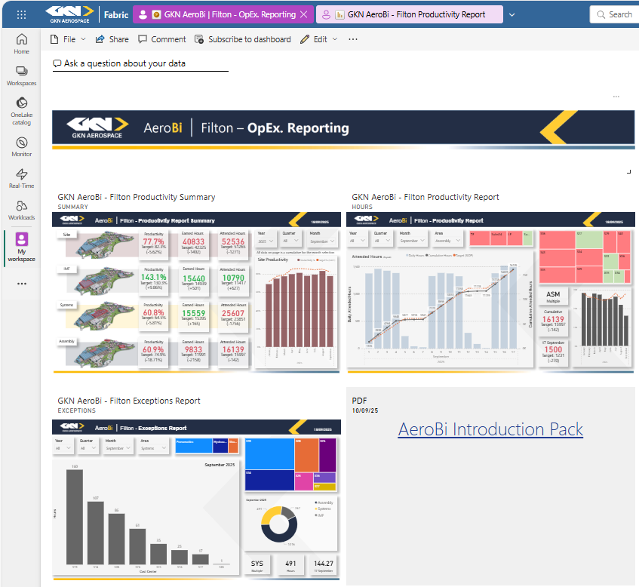
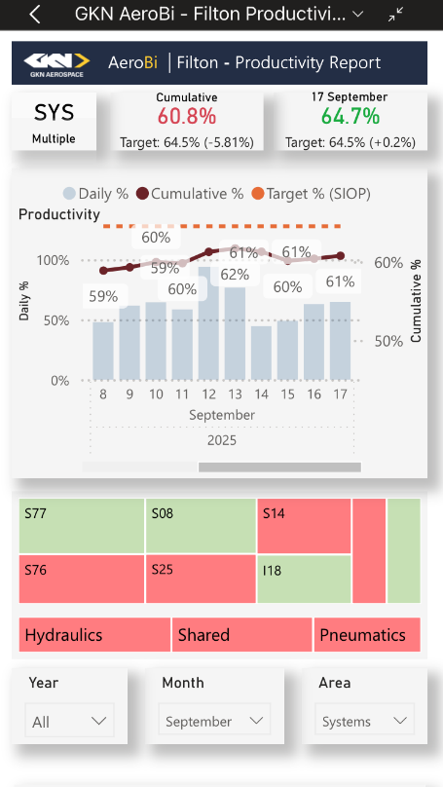


Fabric Web Browser
Once you have the OpEx. Reporting invitation you can view the dashboard in your ‘My workspace’.
You can either use the tracker on the dashboard, or by clicking the three dots at the top right of the report you can enlarge by choosing the ‘Go to report’ option.
The productivity tracker will be refreshed with the latest Earned Hours/Attended Hours data to the OpEx. Reporting dashboard before 9am each morning (we’re working on getting this time earlier).
PowerBi App
The app will take you to your ‘My workspace’. By selecting the OpEx. dashboard you can view the tracker.
Clicking on the report will open it into a mobile view.
Teams
PowerBi can be added as an app into Teams.
All dashboards and reports, with permission to, will be available to view, share or add to a chat.

Slide 4
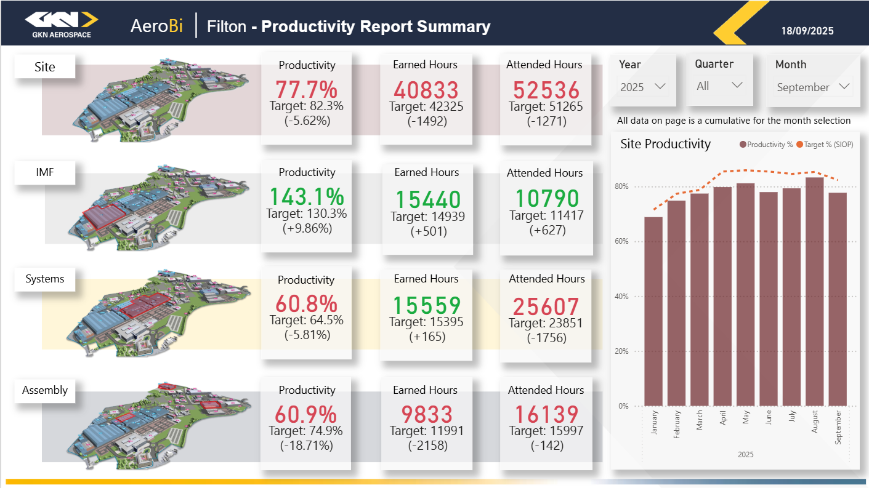
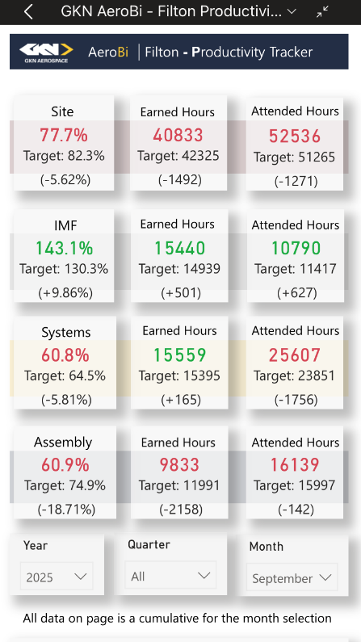
Productivity Summary Report
Fabric on web browser
The Summary page is a quick over view of each business area and Filton as a site.
All data is a cumulative for the date selected – Productivity, Earned Hours and Attended Hours.
The bar chart shows the site productivity for the year by month.
The mobile view has the same data visuals.
Scrolling down will display the monthly bar chart.
PowerBi on mobile app

Slide 5
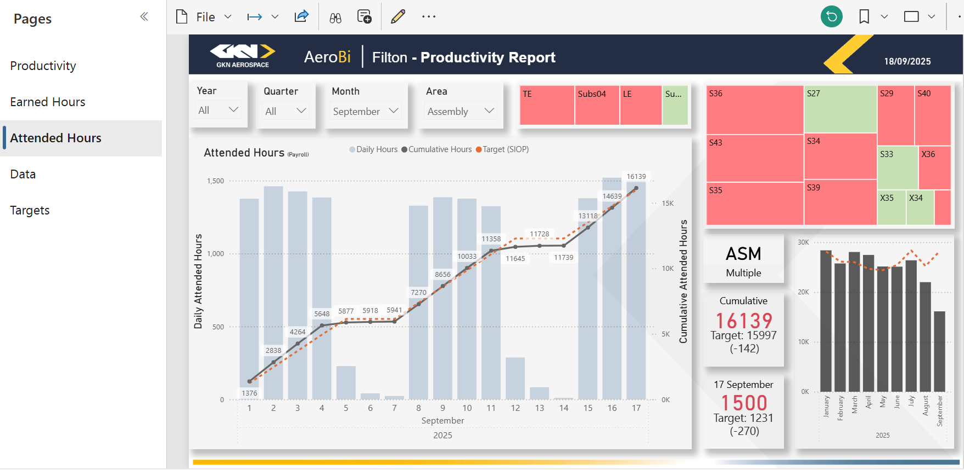
Fabric Web Browser - Productivity Report
Green/Red visual shows what areas are above or below their target.
The farther an area is from its target, the larger the box appears.
Hovering over the dropdown boxes and selecting the eraser will clear filter
Use the dropdown filters for Dates and Business Area.
Business area will dynamically change the Value Stream and Cost Center selection options.
There are report pages for Productivity, Earned Hours and Attended Hours, with an additional two pages to view and filter through the raw data that drives the Report pages.
Selecting a Business Area, Value Stream or individual Cost Center will update the charts and data to the selected area.
The months graph will show Cumulative data and Target data for Business Area selected only.
When a Value Stream or Cost Center are selected the bar will show how that selection contributed to that Business Areas data.
The main graph shows the daily metric on the left y-axis, visualised as a bar chart, a cumulative metric on the right y-axis, visualised as a solid line with data points and a target visualised as a dashed line.
The bars are grouped for the areas, selecting a Cost Center will adjust the bar to show how that area contributes to the groups overall data.
Clicking on a bar or line will show the data for that date.
Hovering the mouse over an area, bar, line or card will call out the latest data for that point.
The data cards show the area that the data is showing for, for example: Cumulative - Green is plus, Red is minus - Target, delta cumulative from target, and the previous day, if ‘NA’ is shown the report hasn’t been updated or the month selection isn’t for the current month.

Slide 6
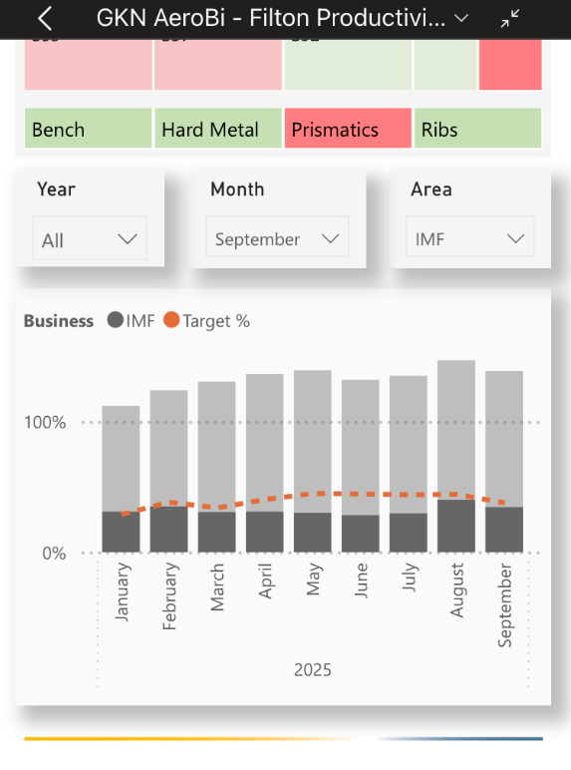
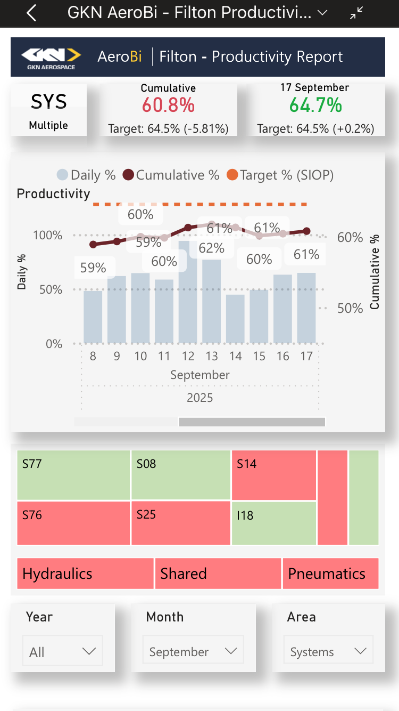
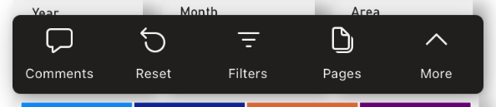
PowerBi App - Productivity Report
Scroll down to view months graph.
The data cards show the area that the data is showing for, Cumulative - Green is plus, Red is minus, Target, delta cumulative from target, and the previous days - if NA is shown the report hasn’t been updated or the month selection isn’t for the current month.
The main graph shows Daily data on the left y-axis, visualised as a bar chart, a Cumulative data on the right y-axis, visualised as a solid line with data points and a Target visualised as a dashed line.
In mobile view the graph is shows up to 9 days at a time, scrolling from left to right gives the user full visual of the month.
Select Pages from the ribbon that appears at the bottom or the dropdown from the top of the screen to view all pages.
Green/Red visual shows what areas are above or below target.
The farther an area is from its target, the larger the box appears.
Selecting a Business Area, Value Stream or individual Cost Center will update the charts and data to the selected area.
Drop down filtering for Dates and Business Area.
Rotating your mobile horizontally will display the tracker into landscape mode.

Slide 7
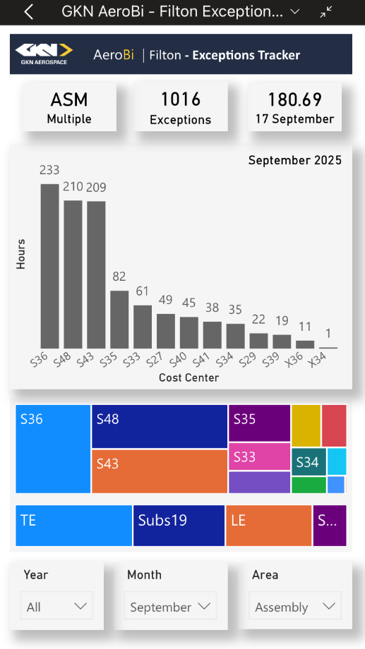
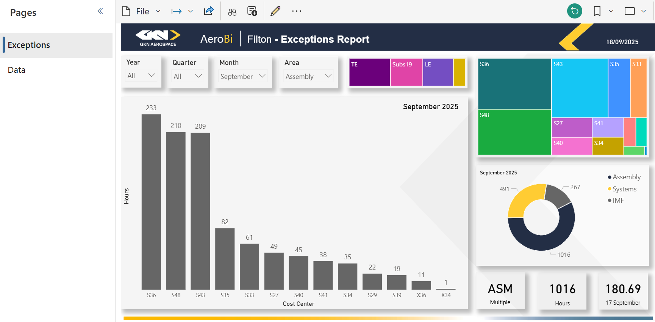
Exceptions Report
PowerBi on mobile app
Use the drop down to view page selection.
Similar lay out and configuration to the Productivity Report. Designed to view the amount of exceptions in hours for any selected area.
The size of the area box relates to the number of exception hours in that area – bigger in size = larger number of hours.
There is a report and raw data page to view.
Simple donut chart to view each business area.
Scroll down on the mobile app to view.
Area selected, total number of exception hours for area/date selected and total for the previous day visual cards.
Fabric on web browser

Slide 8


Further Information
The dashboard is now live and ready to be shared with business leaders, along with this introduction pack. When sharing be aware and mindful of whom you allow sharing privileges.
Additional reports/trackers are currently in development and will be released through the dashboard in due course, accompanied by further communications.
We welcome any questions, feedback, or ideas to enhance the dashboard and trackers - please feel free to reach out to any member of the team.

Slide 9

OpEx. Team Mission:
Our mission is to drive Operational Excellence through Continuous Improvement, Innovation, and Efficiency. We foster a Positive, Inclusive workplace that enhances Wellbeing, Boosts productivity, and delivers lasting value to our stakeholders for Sustainable growth.

